Slide 1
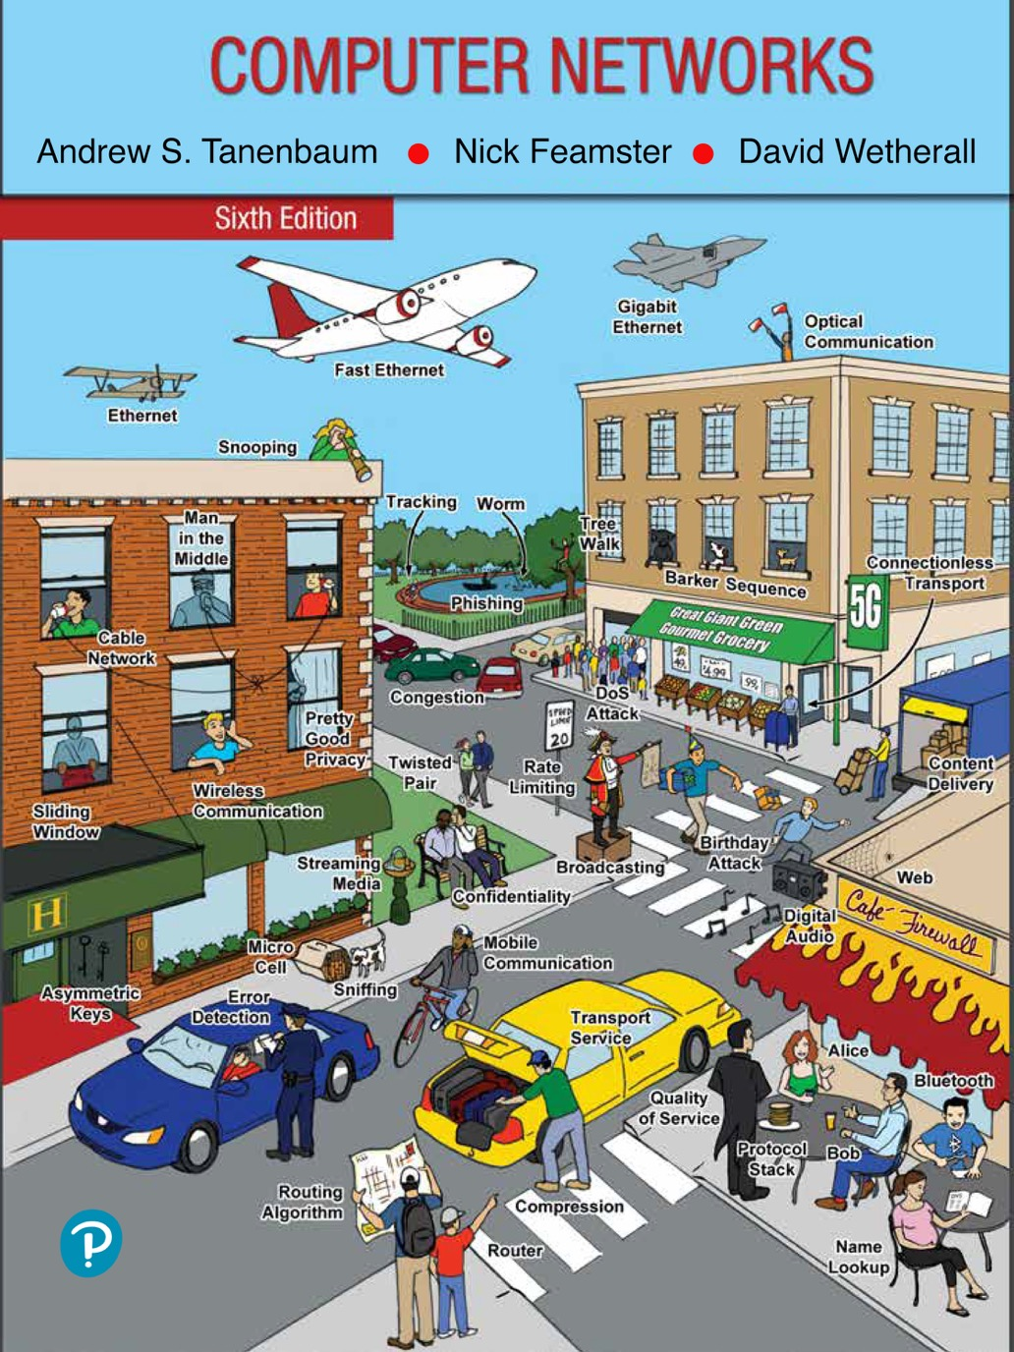
Chapter 6
The Transport Layer

Slide 2
The Transport Service
Services provided to the upper layers
Transport service primitives
Berkeley sockets
Example of socket programming: an Internet file server

Slide 3
The Transport Service
The goal of the transport layer is to provide efficient, reliable, and cost-effective data transmission service to its users, normally processes in the application layer.
The transport layer makes use of the services provided by the network layer. The software and/or hardware within the transport layer that does the work is called the transport entity.
The transport entity can be located in the operating system kernel, in a library package bound into network applications, in a separate user process, or even on the network interface card.

Slide 4
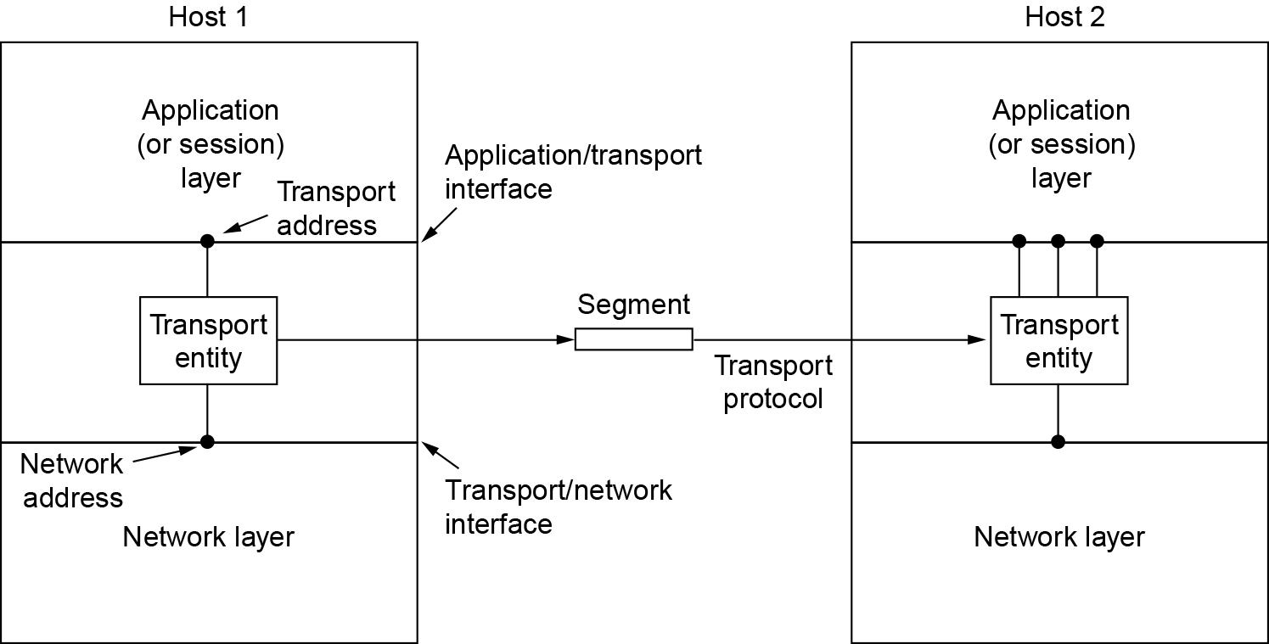
Services Provided to the Upper Layers
The network, transport, and application layers

Slide 5
The Transport Service
If the transport layer service is so similar to the network layer service, why are there two distinct layers? Why is one layer not adequate?
The transport code runs entirely on the users’ machines, but the network layer largely runs on the routers, which are operated by the carrier (at least for a wide area network).
What happens if the network layer offers inadequate service? What if it frequently loses packets? What happens if routers crash from time to time?
The users have no real control over the network layer, so they cannot solve the problem of poor service by using better routers or putting more error handling in the data link layer because they don’t own the routers. The only possibility is to put on top of the network layer another layer that improves the quality of the service.

Slide 6
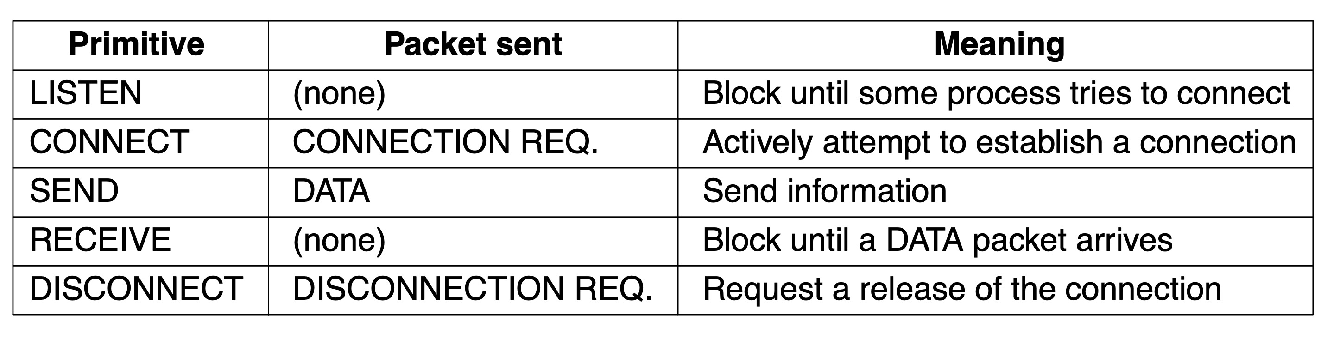
Transport Service Primitives (1 of 2)
The server executes a LISTEN primitive, typically by calling a library procedure that makes a system call that blocks the server until a client turns up.
When a client wants to talk to the server, it executes a CONNECT primitive. The transport entity carries out this primitive by blocking the caller and sending a packet to the server.
The primitives for a simple transport service

Slide 7
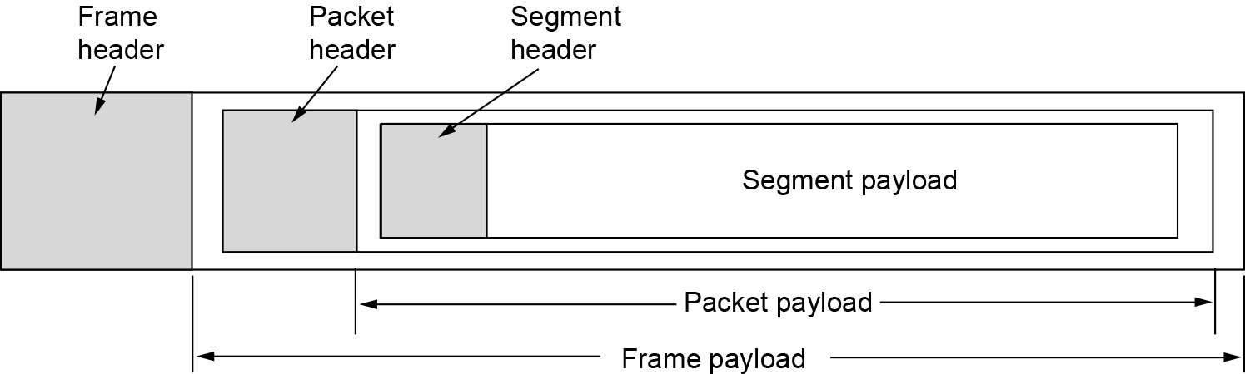
Transport Service Primitives (2 of 2)
We will use the term segment for messages sent from transport entity to transport entity.
Segments (exchanged by the transport layer) are contained in packets (which are exchanged by the network layer). In turn, these packets are contained in frames (exchanged by the data link layer).
When a frame arrives, the data link layer processes the frame header and, if the destination address matches for local delivery, passes the contents of the frame payload field up to the network entity. The network entity similarly processes the packet header and then passes the contents of the packet payload up to the transport entity.
Nesting of segments, packets, and frames

Slide 8
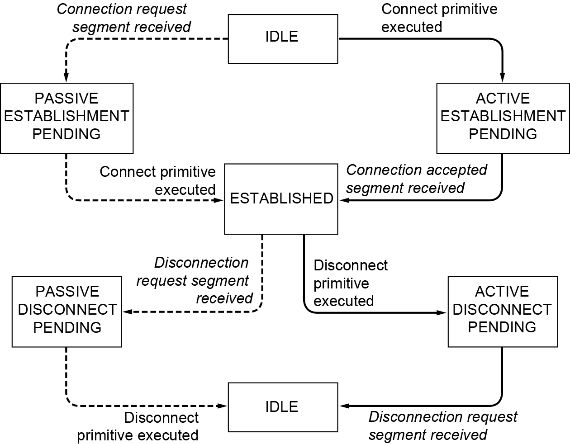
A simple connection management scheme
A state diagram for a simple connection management scheme. Transitions labeled in italics are caused by packet arrivals. The solid lines show the client’s state sequence. The dashed lines show the server’s state sequence.

Slide 9
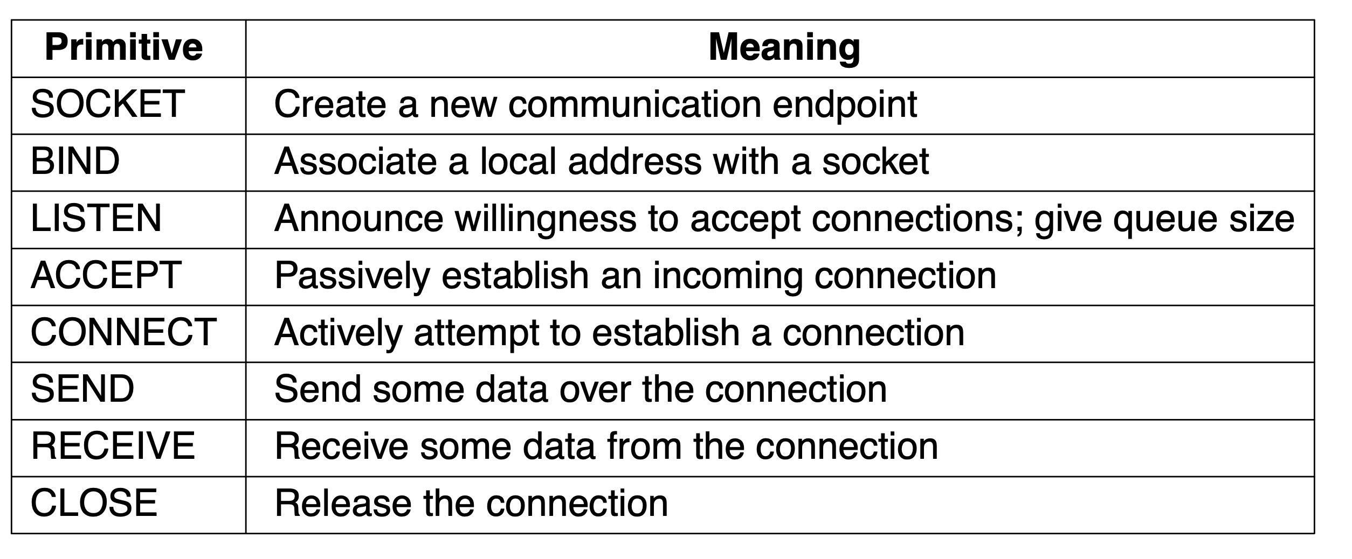
Berkeley Sockets (2 of 2)
Socket primitives were first released as part of the Berkeley UNIX 4.2BSD software distribution in 1983. They quickly became popular. The primitives are now widely used for Internet programming on many operating systems.
The socket primitives for TCP

Slide 10
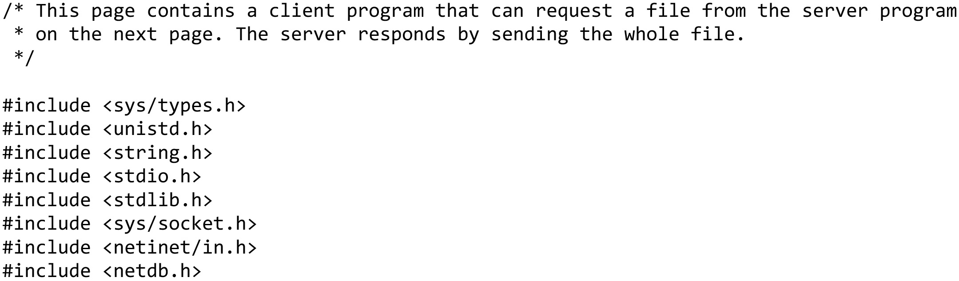
An Example of Socket Programming: An Internet File Server (1 of 10)
Client code using sockets … continued on the next slide

Slide 11
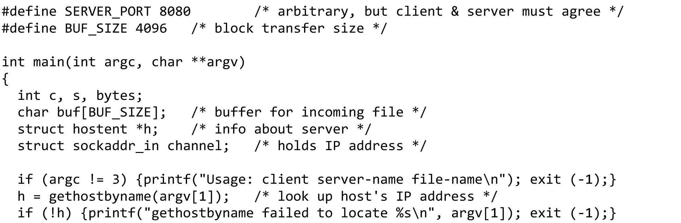
An Example of Socket Programming: An Internet File Server (2 of 10)
Client code using sockets … continued on the next slide

Slide 12
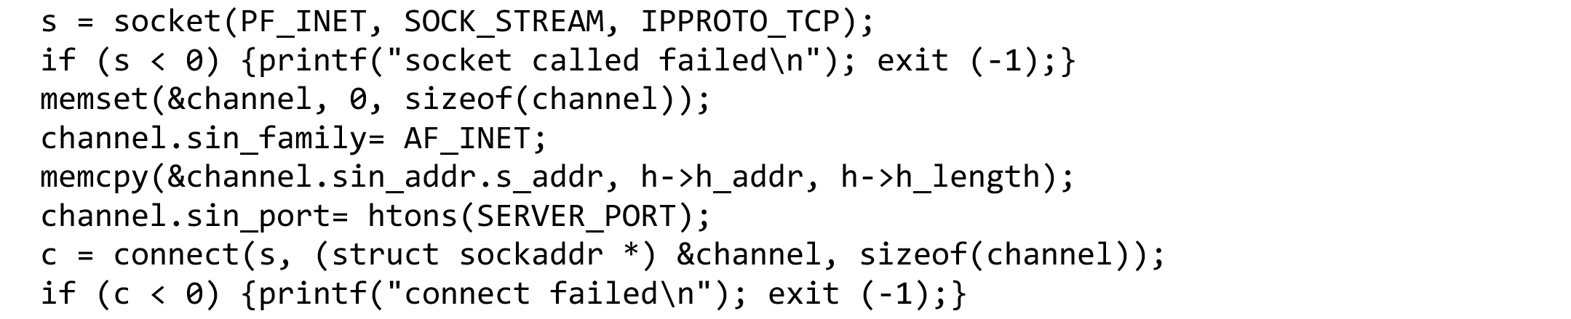
An Example of Socket Programming: An Internet File Server (3 of 10)
Client code using sockets … continued on the next slide

Slide 13
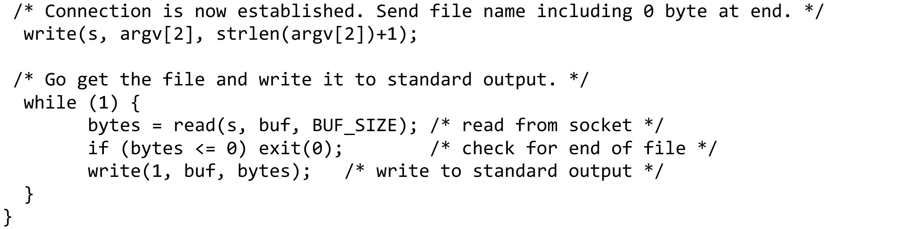
An Example of Socket Programming: An Internet File Server (4 of 10)
Client code using sockets (end of client code)

Slide 14
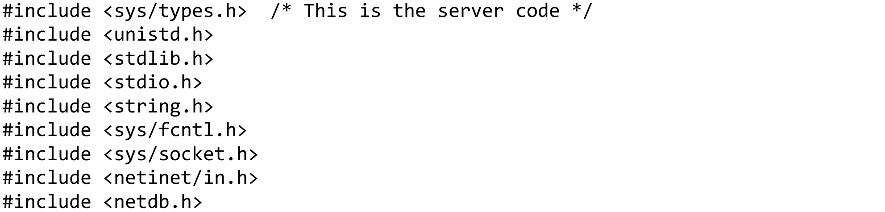
An Example of Socket Programming: An Internet File Server (5 of 10)
Server code using sockets … continued on the next slide

Slide 15
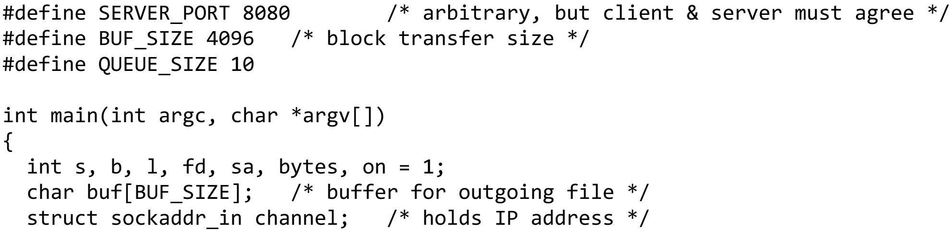
An Example of Socket Programming: An Internet File Server (6 of 10)
Server code using sockets … continued on the next slide

Slide 16
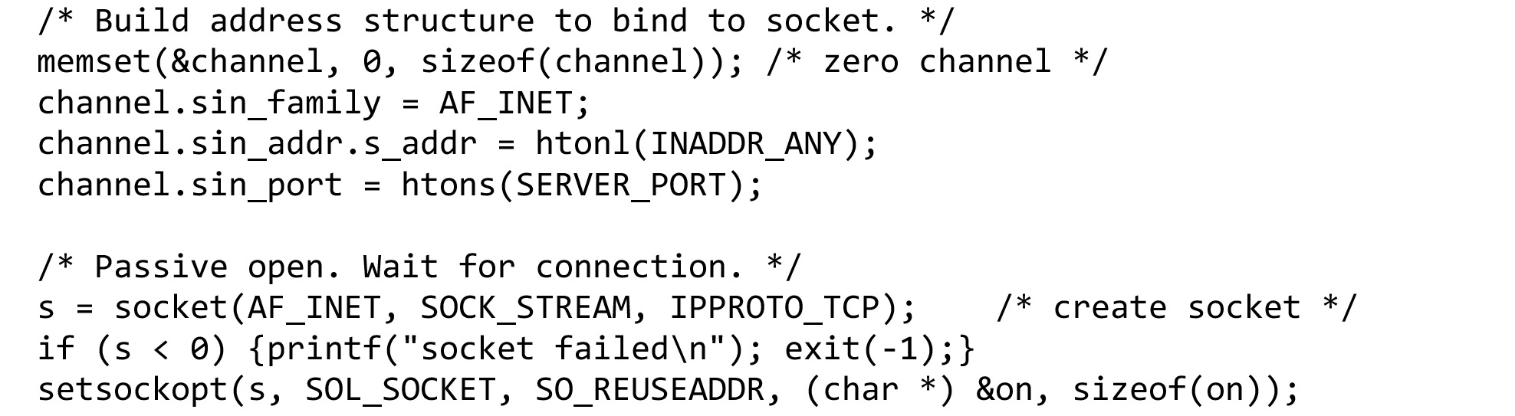
An Example of Socket Programming: An Internet File Server (7 of 10)
Server code using sockets … continued on the next slide

Slide 17
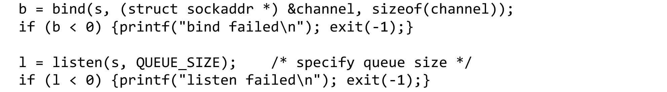
An Example of Socket Programming: An Internet File Server (8 of 10)
Server code using sockets … continued on the next slide

Slide 18
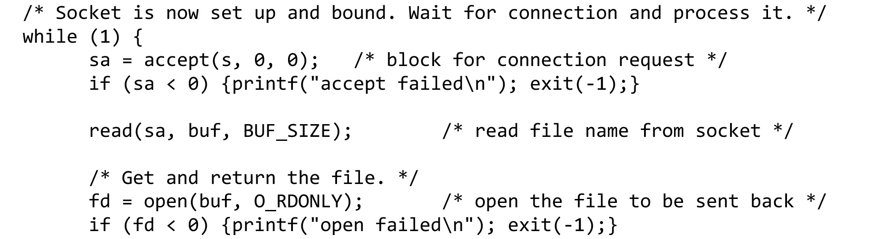
An Example of Socket Programming: An Internet File Server (9 of 10)
Server code using sockets … continued on the next slide

Slide 19
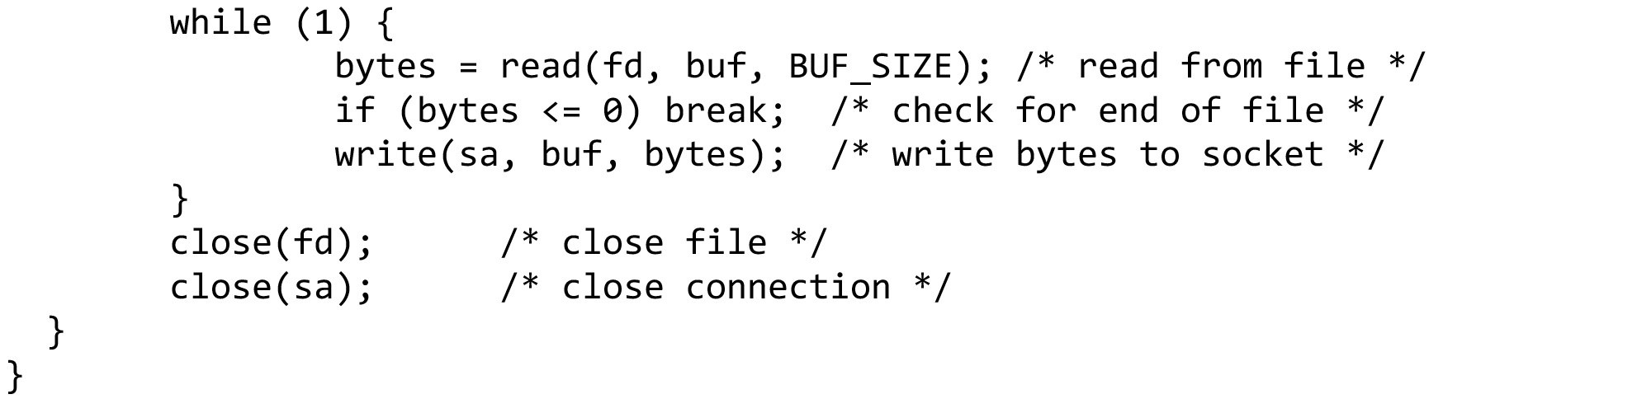
An Example of Socket Programming: An Internet File Server (10 of 10)
Server code using sockets (end of code)

Slide 20
Elements of Transport Protocols (1 of 2)
Addressing
Error control and flow control
Multiplexing
Crash recovery

Slide 21
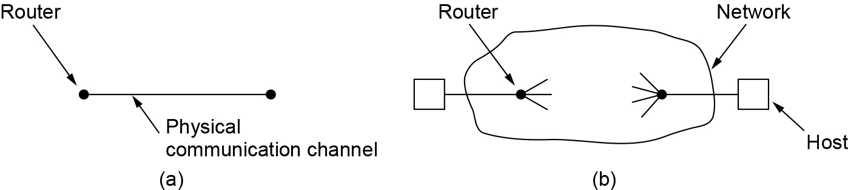
Elements of Transport Protocols (2 of 2)
At the data link layer, two routers communicate directly via a physical channel, whether wired or wireless, whereas at the transport layer, this physical channel is replaced by the entire network. This difference has many important implications for the protocols.
(a) Environment of the data link layer. (b) Environment of the transport layer.

Slide 22
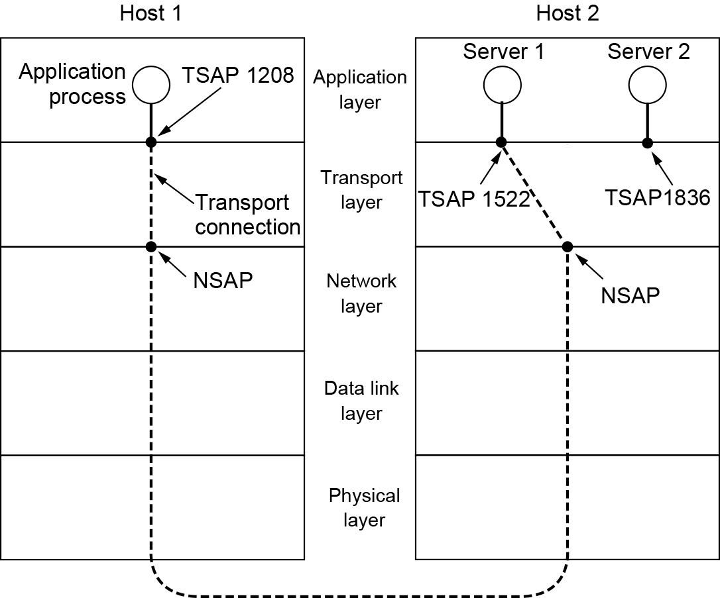
Addressing (1 of 2)
the transport addresses to which processes can listen for connection requests are called ports.
We will use the generic term TSAP (Transport Service Access Point) to mean a specific endpoint in the transport layer.
The analogous endpoints in the network layer are called NSAPs (Network Service Access Points). IP addresses are examples of NSAPs.
TSAPs, NSAPs, and transport connections

Slide 23
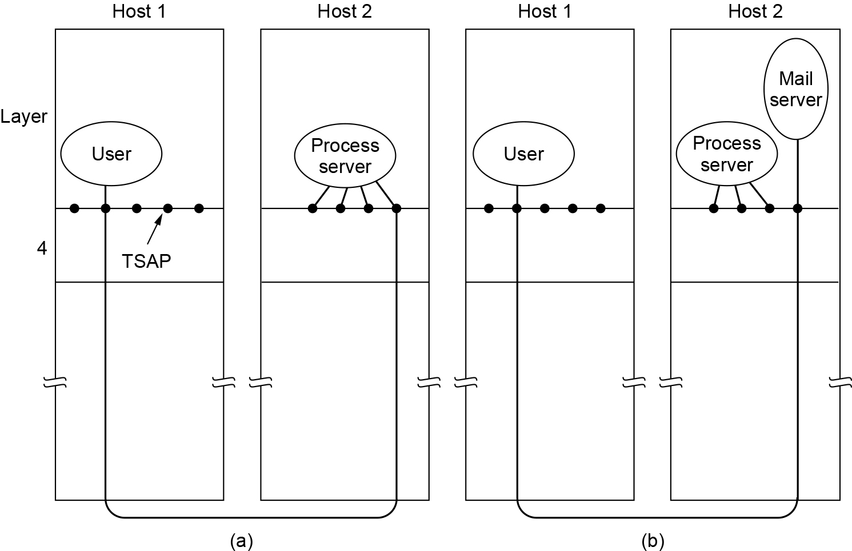
Addressing (2 of 2)
Initial connection protocol: Instead of every conceivable server listening at a well-known TSAP, each machine that wishes to offer services to remote users has a special process server that acts as a proxy for less heavily used servers.
It listens to a set of ports at the same time, waiting for a connection request. If no server is waiting for them, they get a connection to the process server.
The new server does the requested work, while the process server goes back to listening for new requests,
How a user process in host 1 establishes a connection with a mail server in host 2 via a process server

Slide 24
Error Control and Flow Control
Error control is ensuring that the data is delivered with the desired level of reliability, usually that all of the data is delivered without any errors.
Flow control is keeping a fast transmitter from overrunning a slow receiver.

Slide 25
Error Control and Flow Control
A frame carries an error-detecting code (e.g., a CRC or checksum) that is used to check if the information was correctly received.
A frame carries a sequence number to identify itself and is retransmitted by the sender until it receives an acknowledgement of successful receipt from the receiver. This is called ARQ (Automatic Repeat reQuest).
There is a maximum number of frames that the sender will allow to be outstanding at any time, pausing if the receiver is not acknowledging frames quickly enough. If this maximum is one packet the protocol is called stop-and-wait.
The sliding window protocol combines these features and is also used to support bidirectional data transfer.

Slide 26
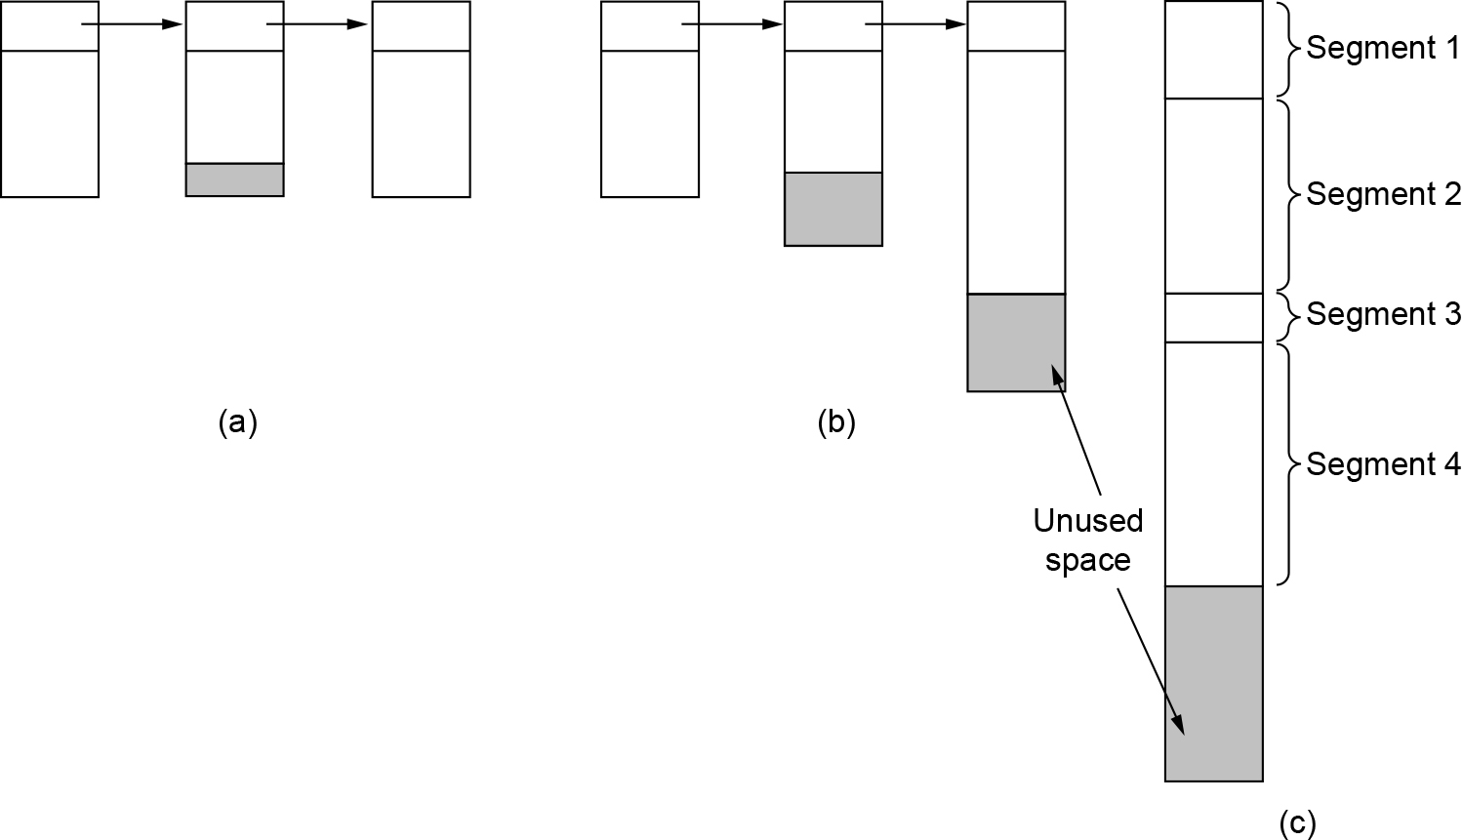
Error Control and Flow Control (1 of 2)
Given that transport protocols generally use larger sliding windows, we will look at the issue of buffering data more carefully.
(a) Chained fixed-size buffers. (b) Chained variable-sized buffers. (c) One large circular buffer per connection.

Slide 27
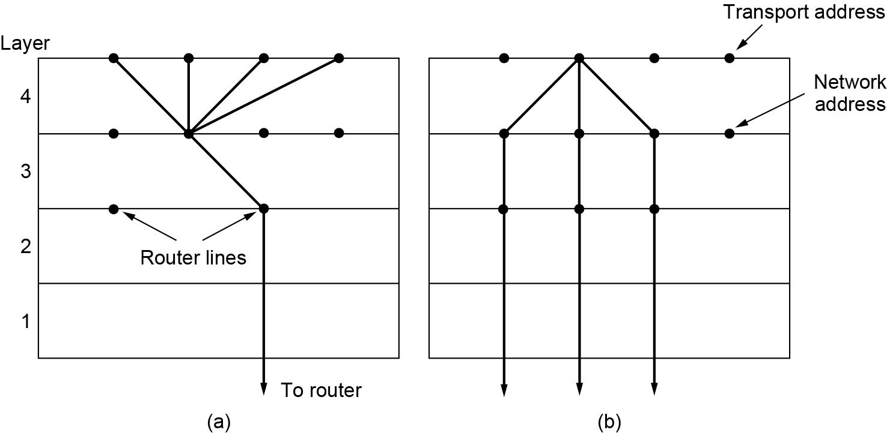
Multiplexing
If only one network address is available on a host, all transport connections on that machine have to use it. When a segment comes in, some way is needed to tell which process to give it to. This situation, called multiplexing
A host has multiple network paths that it can use. If a user needs more bandwidth or more reliability than one of the network paths can provide, a way out is to have a connection that distributes the traffic among multiple network paths on a round-robin basis. This is called inverse multiplexing.
(a) Multiplexing. (b) Inverse multiplexing.

Slide 28
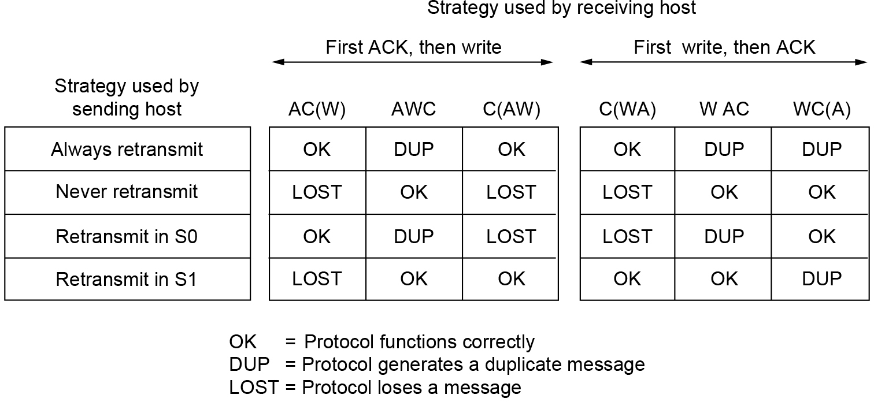
Crash Recovery
Each client can be in one of two states: one segment outstanding, S1, or no segments outstanding, S0.
Three events are possible at the server: sending an acknowledgement (A), writing to the output process (W), and crashing (C). The three events can occur in six different orderings: AC(W), AWC, C(AW), C(WA), WAC, and WC(A), where the parentheses are used to indicate that neither A nor W can follow C (i.e., once it has crashed, it has crashed). All eight combinations of client and server strategies and the valid event sequences for each one. Notice that for each strategy there is some sequence of events that causes the protocol to fail. For example, if the client always retransmits, the AWC event will generate an undetected duplicate, even though the other two events work properly.
Different combinations of client and server strategies

Slide 29
Congestion Control
If the transport entities on many machines send too many packets into the network too quickly, the network will become congested, with performance degraded as packets are delayed and lost.
Controlling congestion to avoid this problem is the combined responsibility of the network and transport layers.
Congestion occurs at routers, so it is detected at the network layer. However, congestion is ultimately caused by traffic sent into the network by the transport layer.
The only effective way to control congestion is for the transport protocols to send packets into the network more slowly.

Slide 30
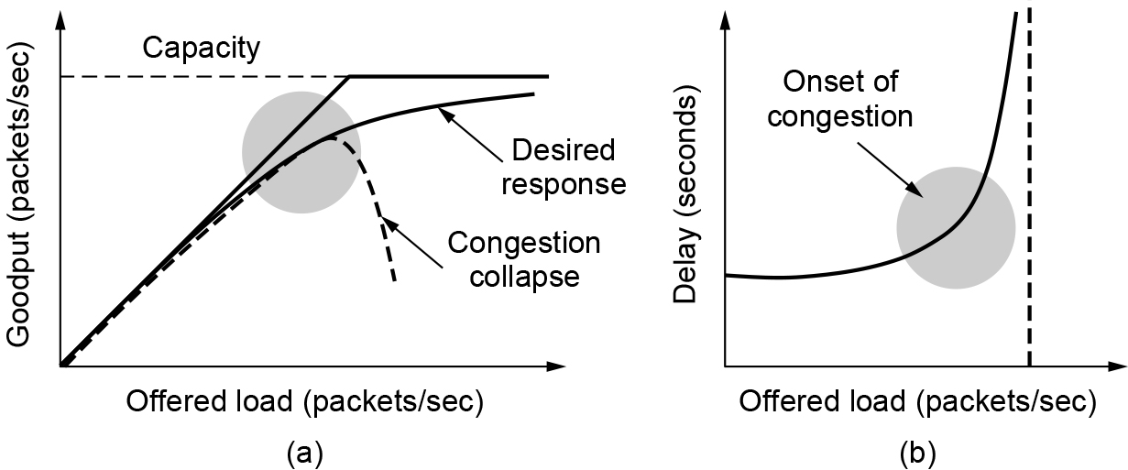
Desirable Bandwidth Allocation: Efficiency and Power
As the load increases, goodput initially increases at the same rate, but as the load approaches the capacity, goodput rises more gradually. This falloff is because bursts of traffic can occasionally mount up and cause some losses at buffers inside the network. If the transport protocol is poorly designed and retransmits packets that have been delayed but not lost, the network can enter congestion collapse. In this state, senders are furiously sending packets, but increasingly little useful work is being accomplished.
(a) Goodput and (b) delay as a function of offered load.

Slide 31
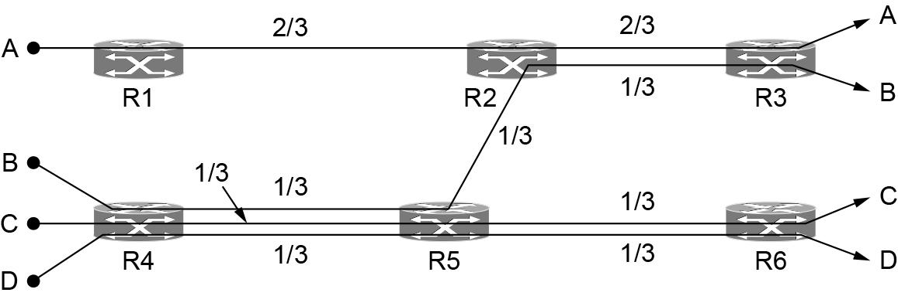
Desirable Bandwidth Allocation: Min-Max Fairness
The form of fairness that is often desired for network usage is max-min fairness. An allocation is max-min fair if the bandwidth given to one flow cannot be increased without decreasing the bandwidth given to another flow with an allocation that is no larger.
Each of the links between routers has the same capacity, taken to be 1 unit, though in the general case the links will have different capacities.
If more of the bandwidth on the link between R2 and R3 is given to flow B, there will be less for flow A. This is reasonable as flow A already has more bandwidth. However, the capacity of flow C or D (or both) must be decreased to give more bandwidth to B, and these flows will have less bandwidth than B. Thus, the allocation is max-min fair.
Max-min bandwidth allocation for four flows

Slide 32
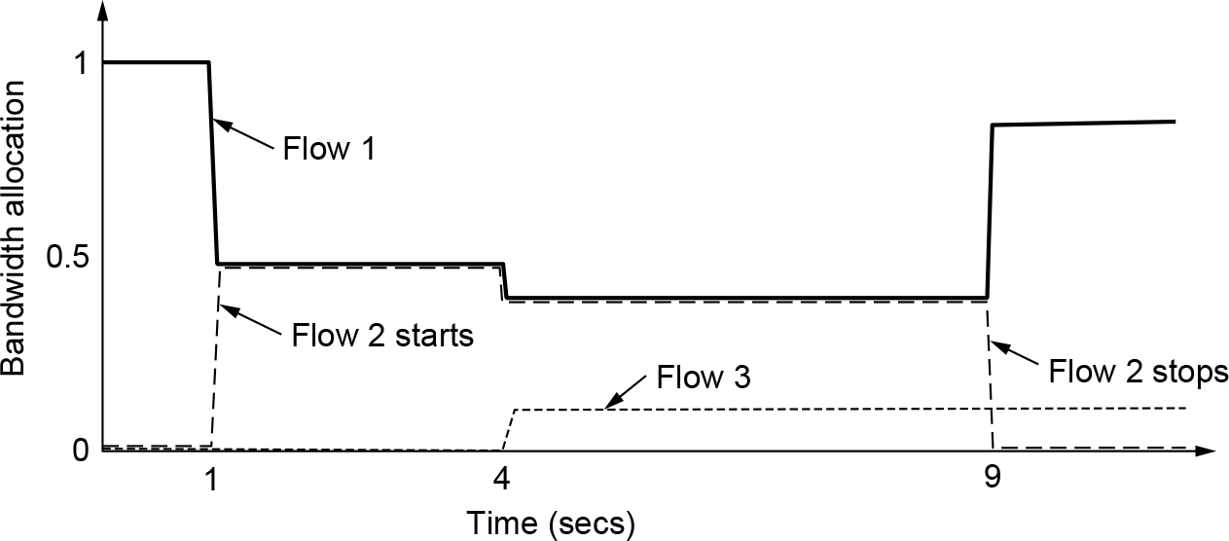
Desirable Bandwidth Allocation: Convergence
Because of the variation in demand, the ideal operating point for the network varies over time. A good congestion control algorithm should rapidly converge to the ideal operating point, and it should track that point as it changes over time. Initially, flow 1 has all of the bandwidth. One second later, flow 2 starts. It needs bandwidth as well. The allocation quickly changes to give each of these flows half the bandwidth. At 4 seconds, a third flow joins. However, this flow uses only 20% of the bandwidth, which is less than its fair share (which is a third). Flows 1 and 2 quickly adjust, dividing the available bandwidth to each have 40% of the bandwidth. At 9 seconds, the second flow leaves, and the third flow remains unchanged. The first flow quickly captures 80% of the bandwidth.
Changing bandwidth allocation over time

Slide 33
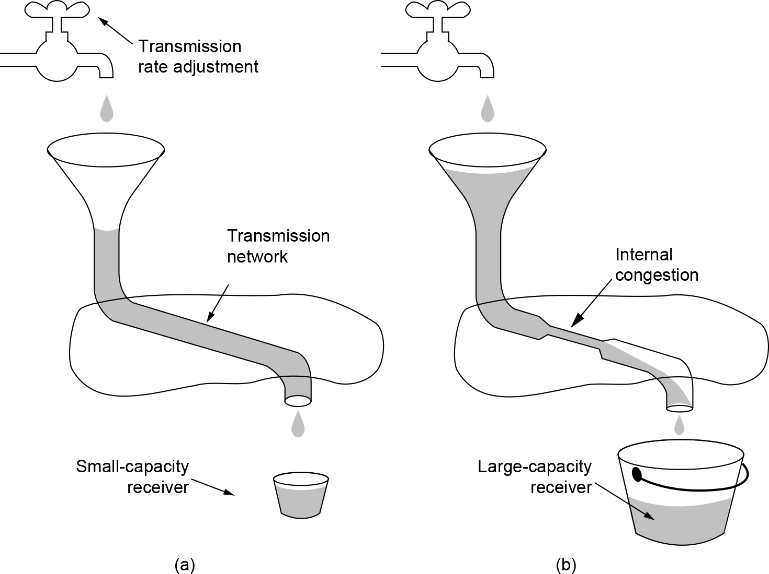
Regulating the Sending Rate
The sending rate may be limited by two factors.
The first is flow control, in the case that there is insufficient buffering at the receiving end.
The second is congestion, in the case that there is insufficient capacity in the network.
In Fig (a), we see a thick pipe leading to a small-capacity receiver. This is a flow-control limited situation. As long as the sender does not send more water than the bucket can contain, no water will be lost.
In Fig (b), the limiting factor is not the bucket capacity, but the internal carrying capacity of the network. If too much water comes in too fast, it will back up and some will be lost (in this case, by overflowing the funnel).
(a) A fast network feeding a low-capacity receiver. (b) A slow network feeding a high-capacity receiver.

Slide 34
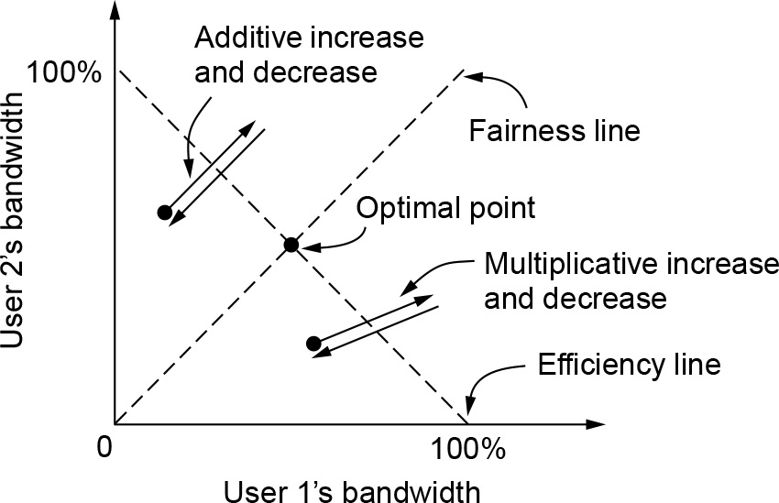
Regulating the Sending Rate (AIMD)
Chiu and Jain (1989) studied the case of binary congestion feedback and concluded that AIMD (Additive Increase Multiplicative Decrease) is the appropriate control law to arrive at the efficient and fair operating point.
Consider what happens from some starting allocation if both user 1 and user 2 additively increase their respective bandwidths over time. Eventually, the operating point crosses the efficiency line, and both users receive a congestion signal from the network. At this stage, they must reduce their allocations. However, an additive decrease would simply cause them to oscillate along an additive line. Similarly, consider the case when both users multiplicatively increase their bandwidth over time until they receive a congestion signal. In neither case will the users converge to the optimal sending rates that are both fair and efficient.
Additive and multiplicative bandwidth adjustments

Slide 35
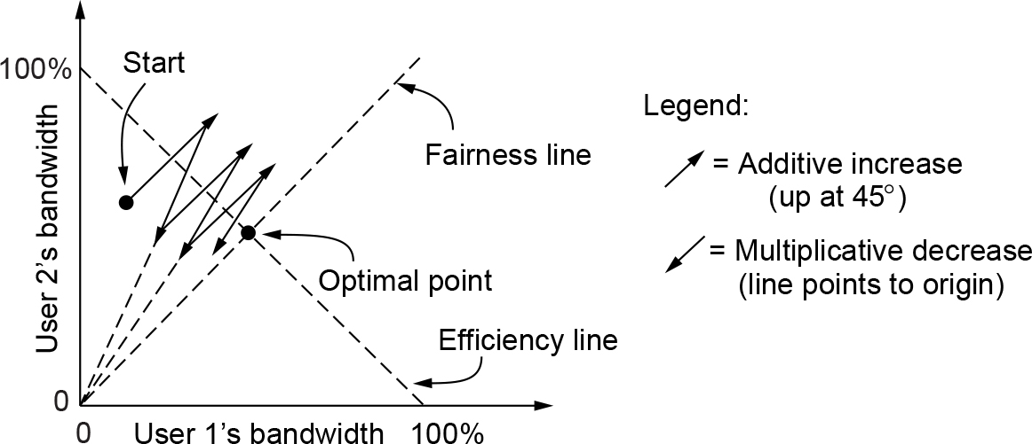
Regulating the Sending Rate (AIMD)
Now consider the case that the users additively increase their bandwidth allocations and then multiplicatively decrease them when congestion is signaled. This behavior is the AIMD control law. It can be seen that the path traced by this behavior does converge to the optimal point that is both fair and efficient.
Additive Increase Multiplicative Decrease (AIMD) control law

Slide 36
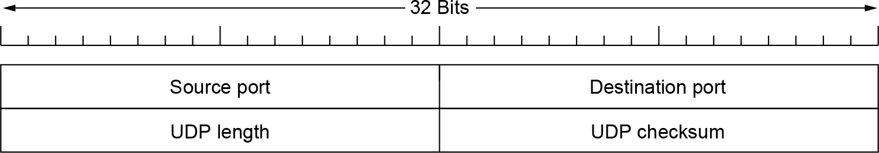
Introduction to UDP
The Internet has two main protocols in the transport layer, a connectionless protocol and a connection-oriented one. The connectionless protocol is UDP (User Datagram Protocol). It does almost nothing beyond sending packets between applications, letting applications build their own protocols on top as needed. UDP provides a way for applications to send encapsulated IP datagrams without having to establish a connection.
The UDP header

Slide 37
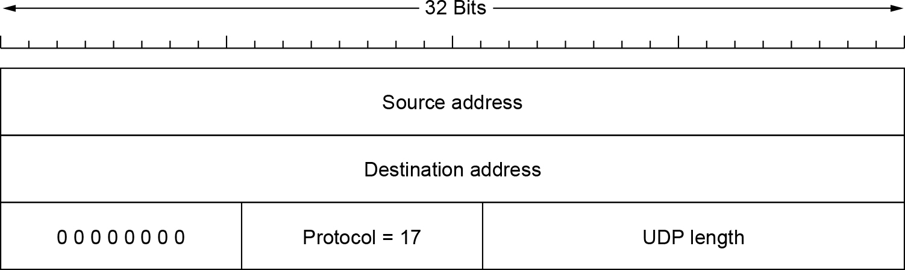
Introduction to UDP (2 of 2)
The IPv4 pseudoheader included in the UDP checksum

Slide 38
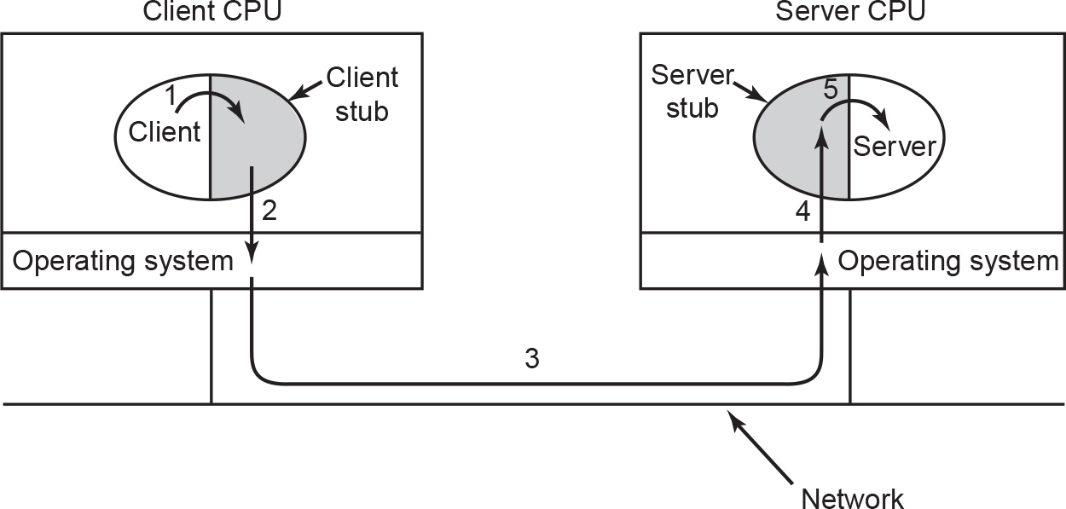
Remote Procedure Call
Steps in making a remote procedure call. The stubs are shaded.

Slide 39
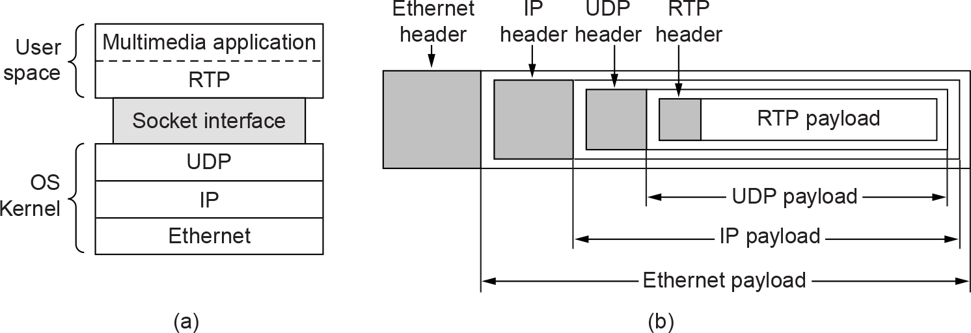
Real-Time Transport Protocols (1 of 4)
(a) The position of RTP in the protocol stack. (b) Packet nesting.

Slide 40
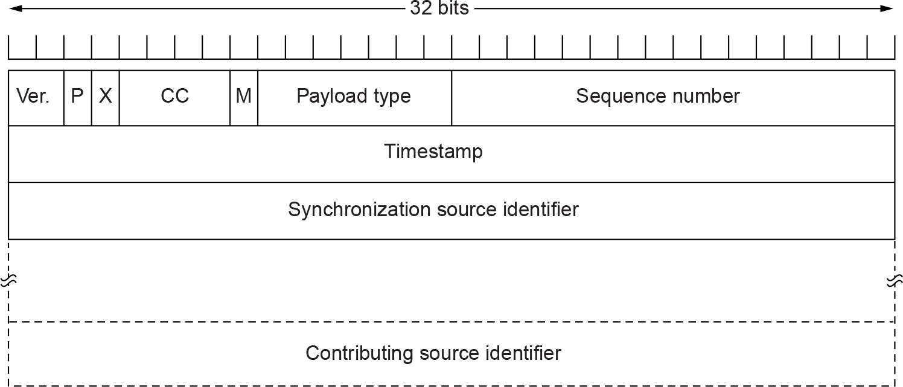
Real-Time Transport Protocols (2 of 4)
The RTP header

Slide 41
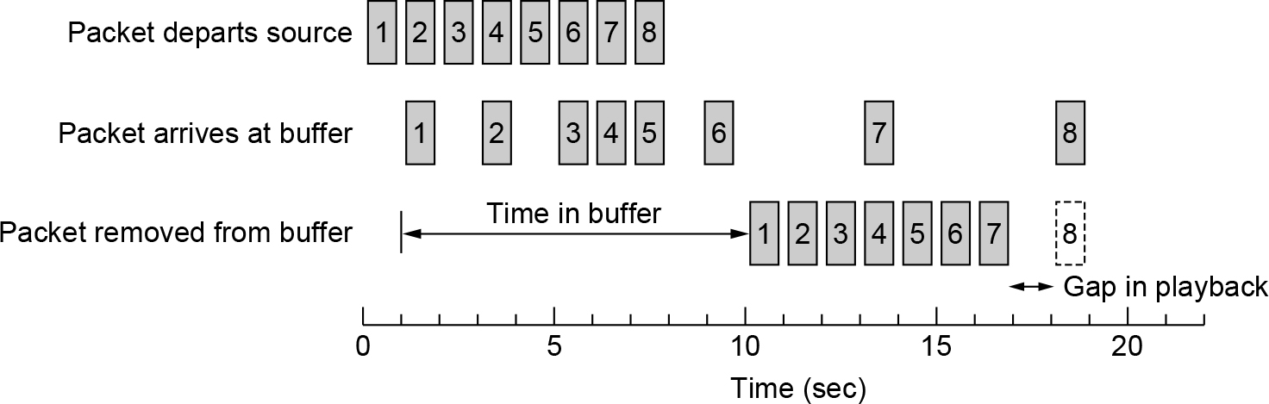
Real-Time Transport Protocols (3 of 4)
Smoothing the output stream by buffering packets

Slide 42
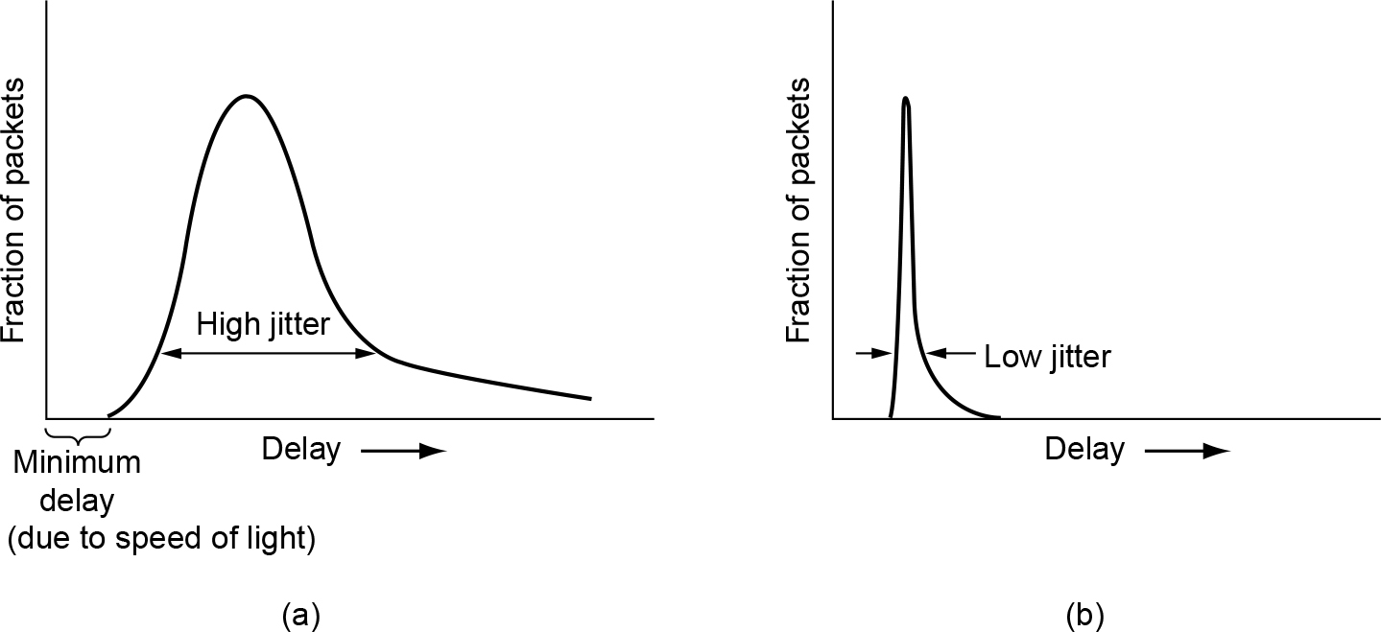
Real-Time Transport Protocols (4 of 4)
(a) High jitter. (b) Low jitter.

Slide 43
The Internet Transport Protocols: TCP (1 of 2)
Introduction to TCP
The TCP service model
The TCP protocol
The TCP segment header
TCP connection establishment
TCP connection release

Slide 44
The Internet Transport Protocols: TCP (2 of 2)
TCP connection management modeling
TCP sliding window
TCP timer management
TCP congestion control
TCP CUBIC

Slide 45
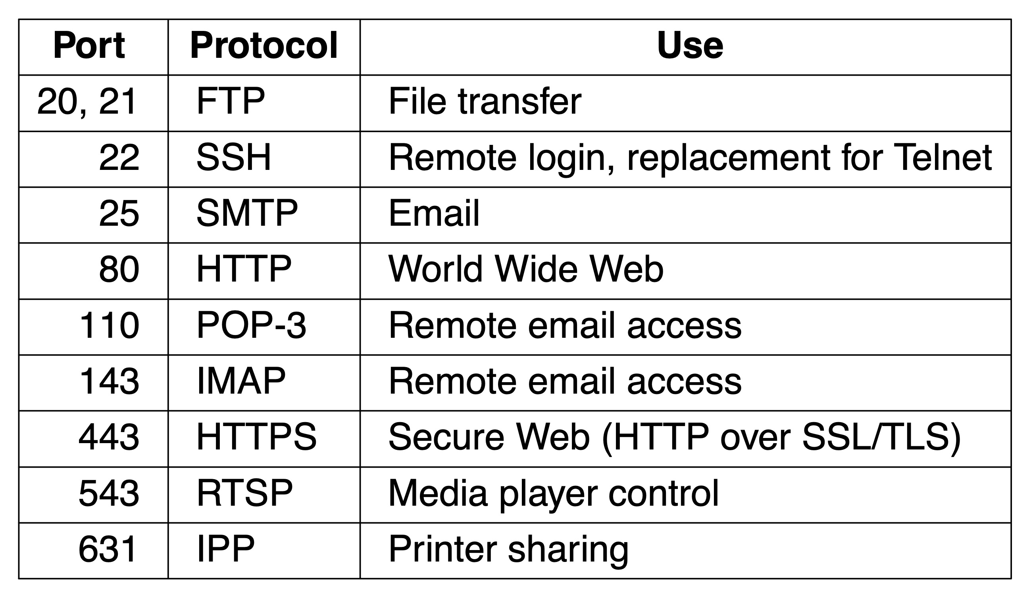
The TCP Service Model (1 of 2)
Some assigned ports

Slide 46
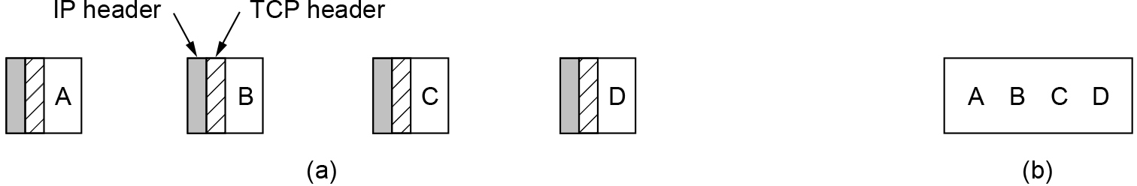
The TCP Service Model (2 of 2)
(a) Four 512-byte segments sent as separate IP datagrams. (b) The 2048 bytes of data delivered to the application in a single READ call.

Slide 47
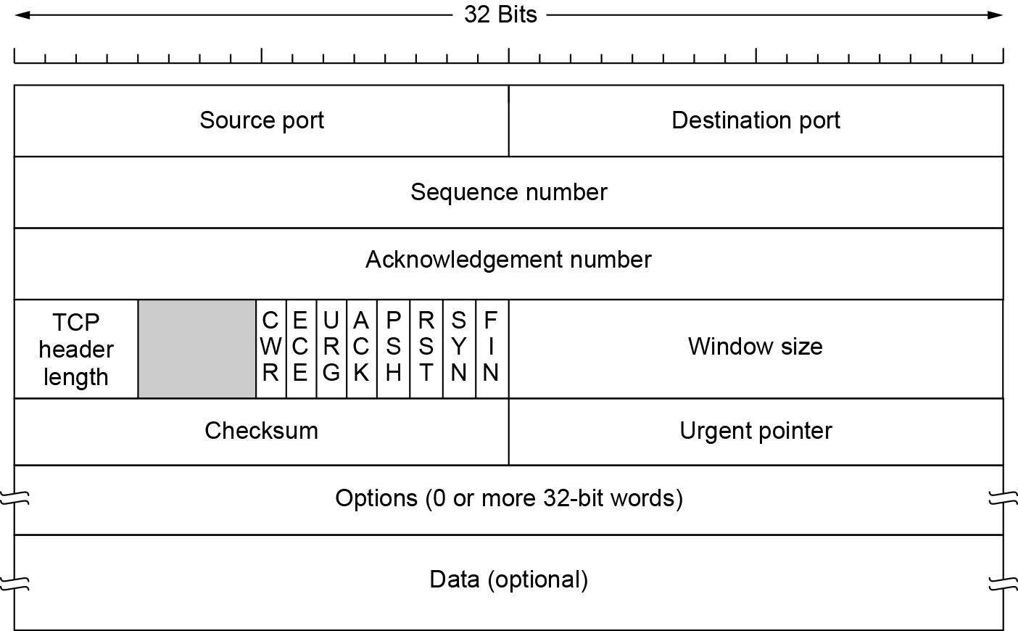
The TCP Segment Header
The TCP header

Slide 48
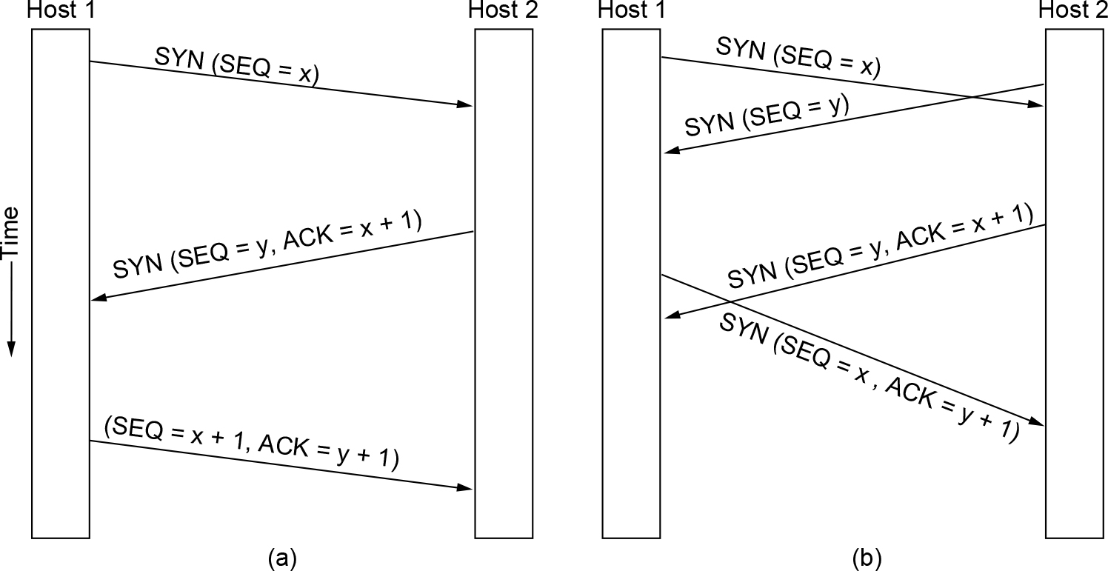
TCP Connection Establishment
(a) TCP connection establishment in the normal case. (b) Simultaneous connection establishment on both sides.

Slide 49
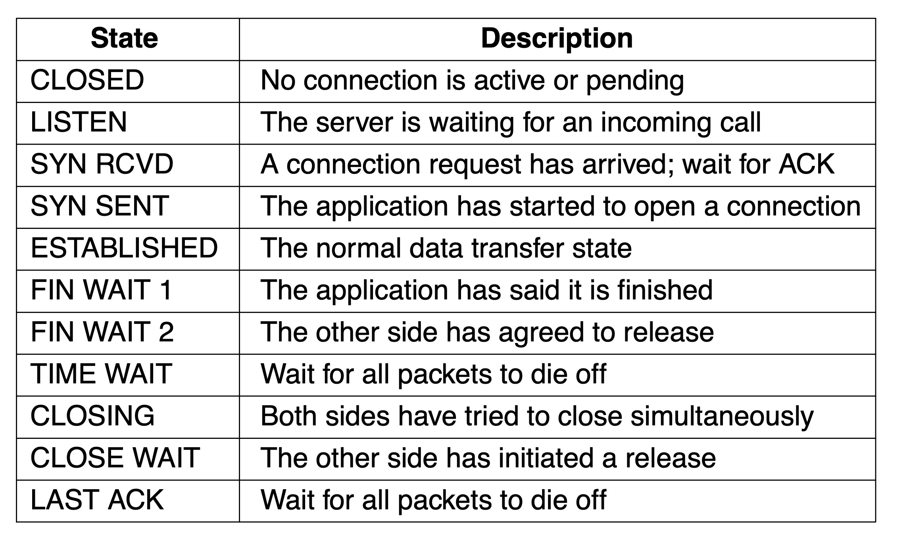
TCP Connection Management Modeling (1 of 2)
The states used in the TCP connection management finite state machine

Slide 50
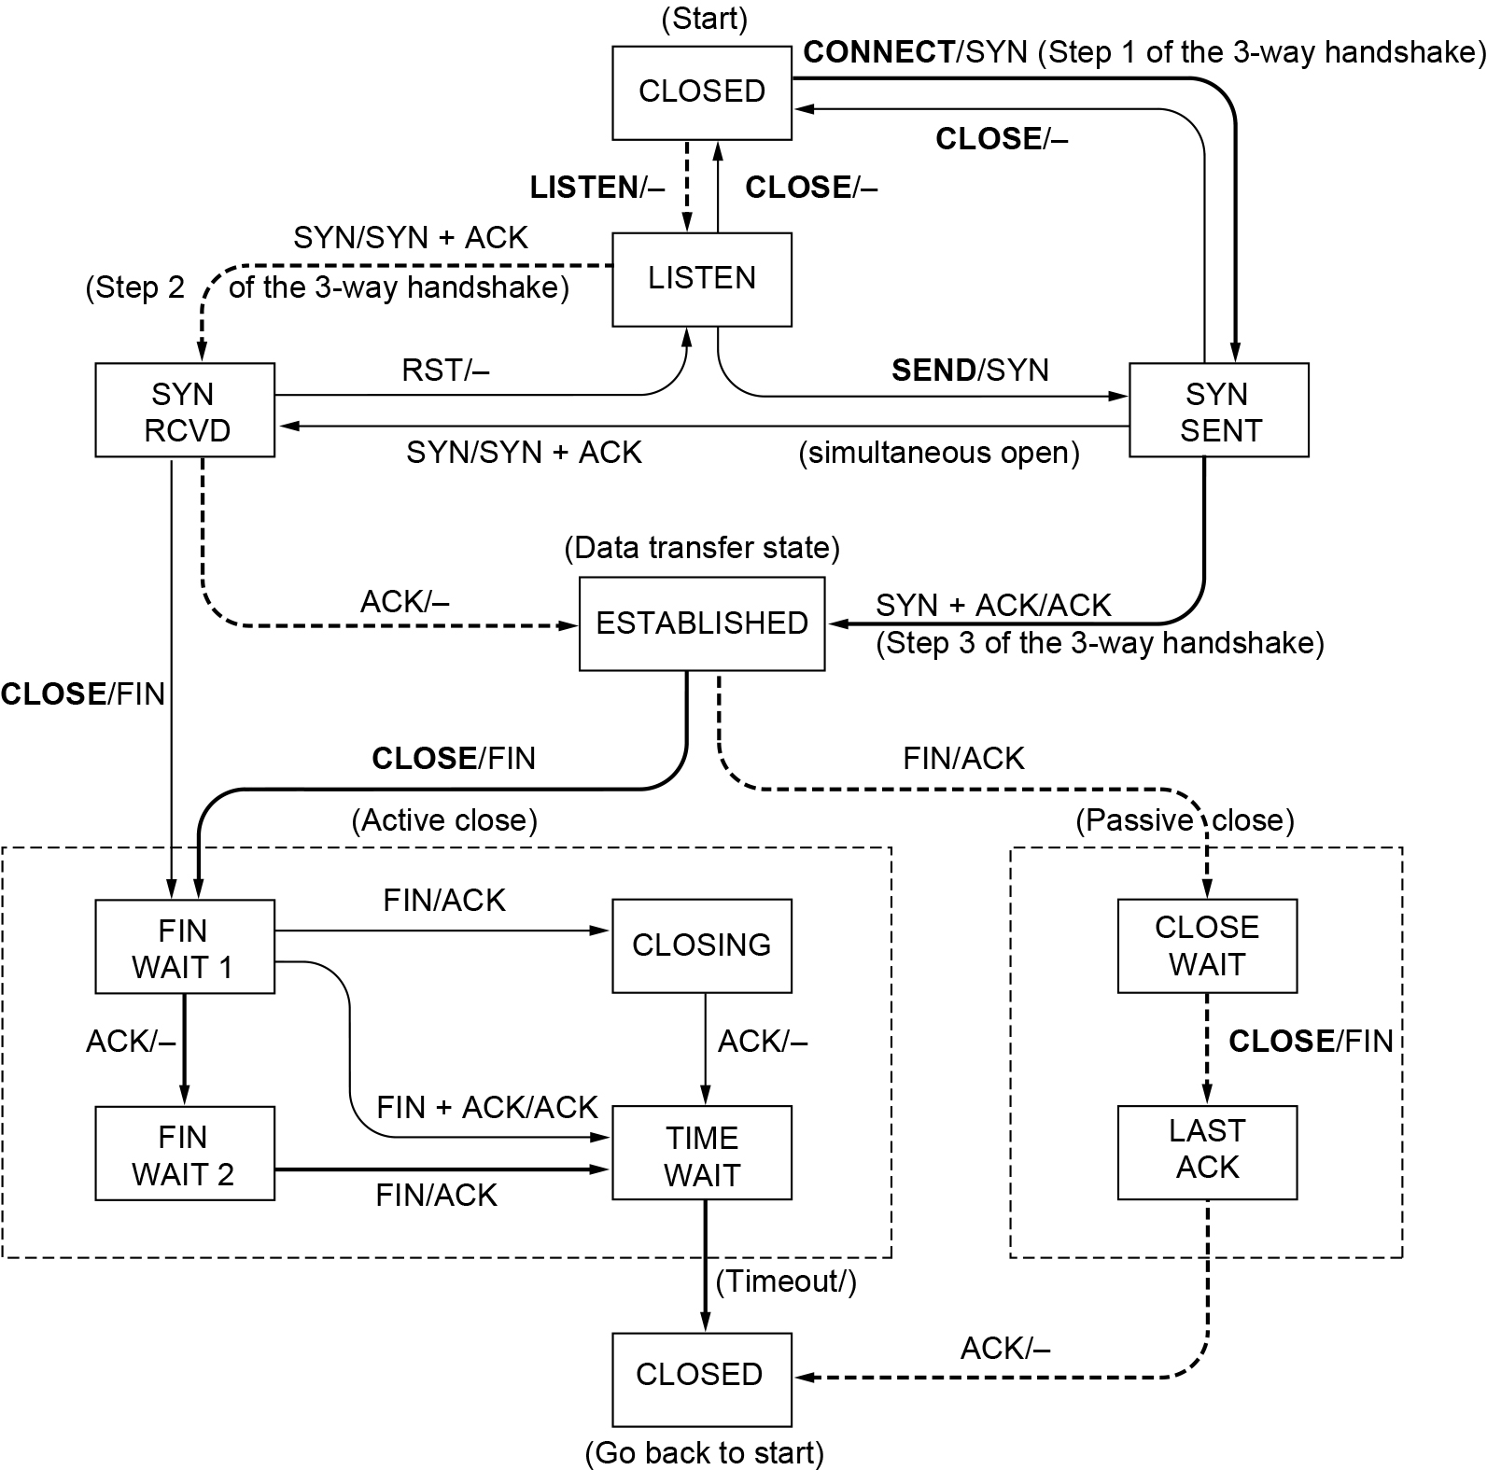
TCP Connection Management Modeling (2 of 2)
TCP connection management finite state machine. The heavy solid line is the normal path for a client. The heavy dashed line is the normal path for a server. The light lines are unusual events. Each transition is labeled with the event causing it and the action resulting from it, separated by a slash.

Slide 51
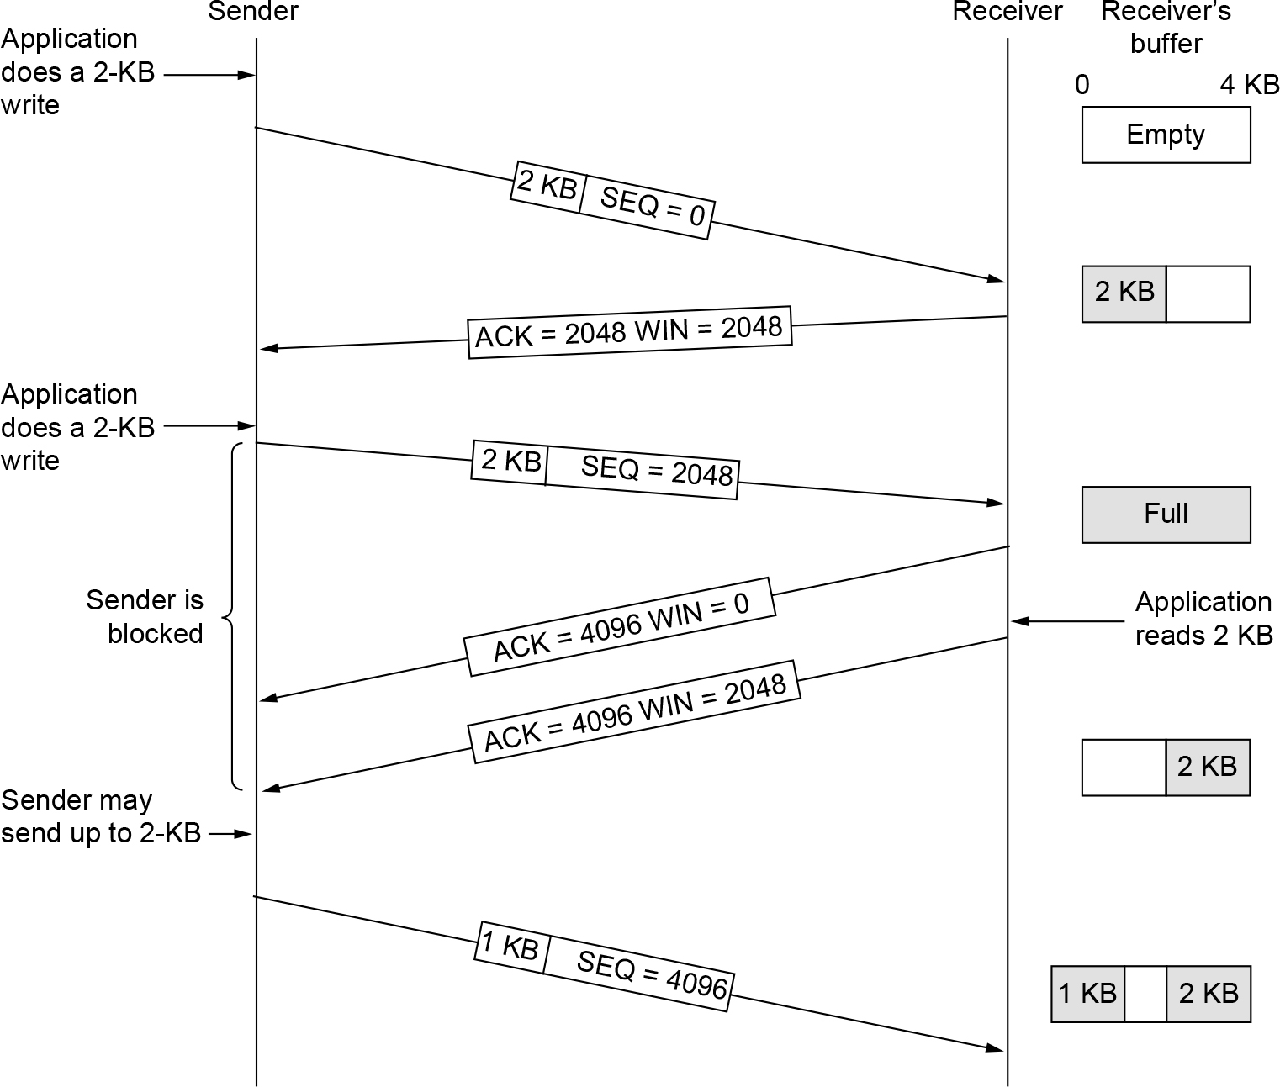
TCP Sliding Window (1 of 2)
Window management in TCP

Slide 52
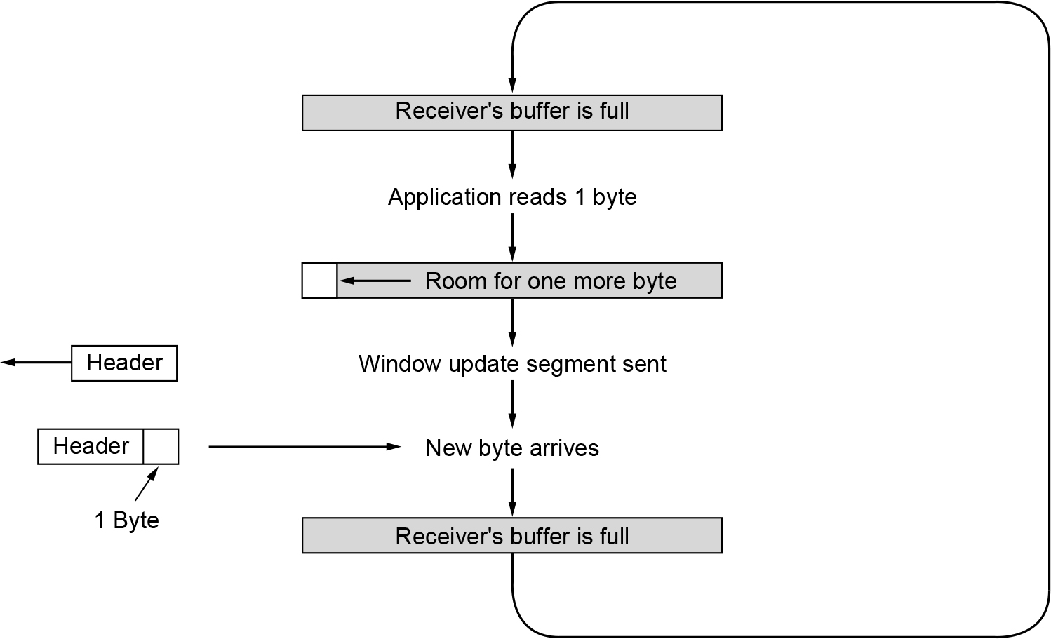
TCP Sliding Window (2 of 2)
Silly window syndrome

Slide 53
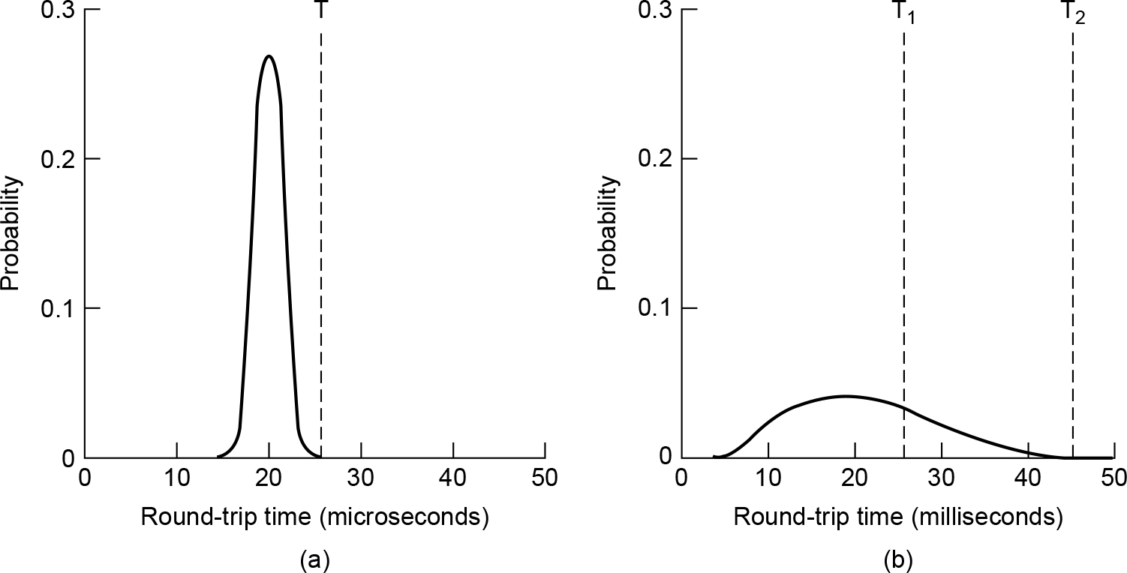
TCP Timer Management
(a) Probability density of acknowledgement arrival times in the data link layer. (b) Probability density of acknowledgement arrival times for TCP.

Slide 54
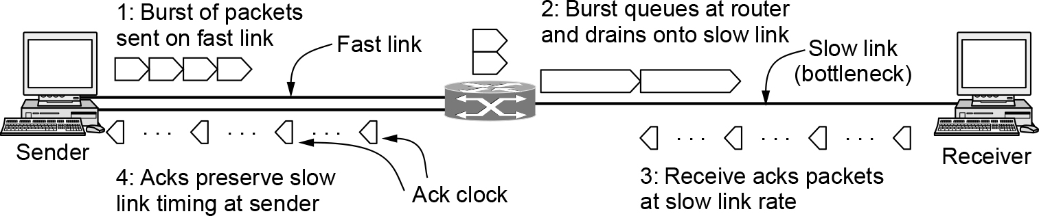
TCP Congestion Control (1 of 6)
A burst of packets from a sender and the returning ack clock

Slide 55
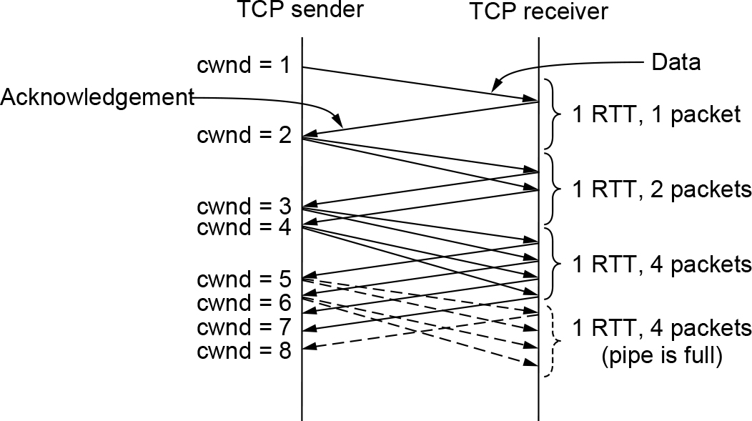
TCP Congestion Control (2 of 6)
Slow start from an initial congestion window of one segment

Slide 56
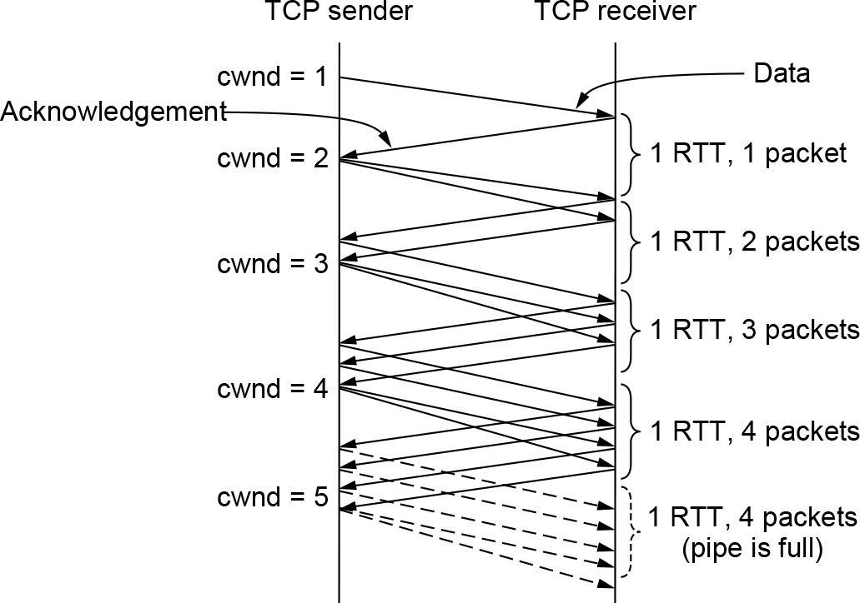
TCP Congestion Control (3 of 6)
Additive increase from an initial congestion window of one segment

Slide 57
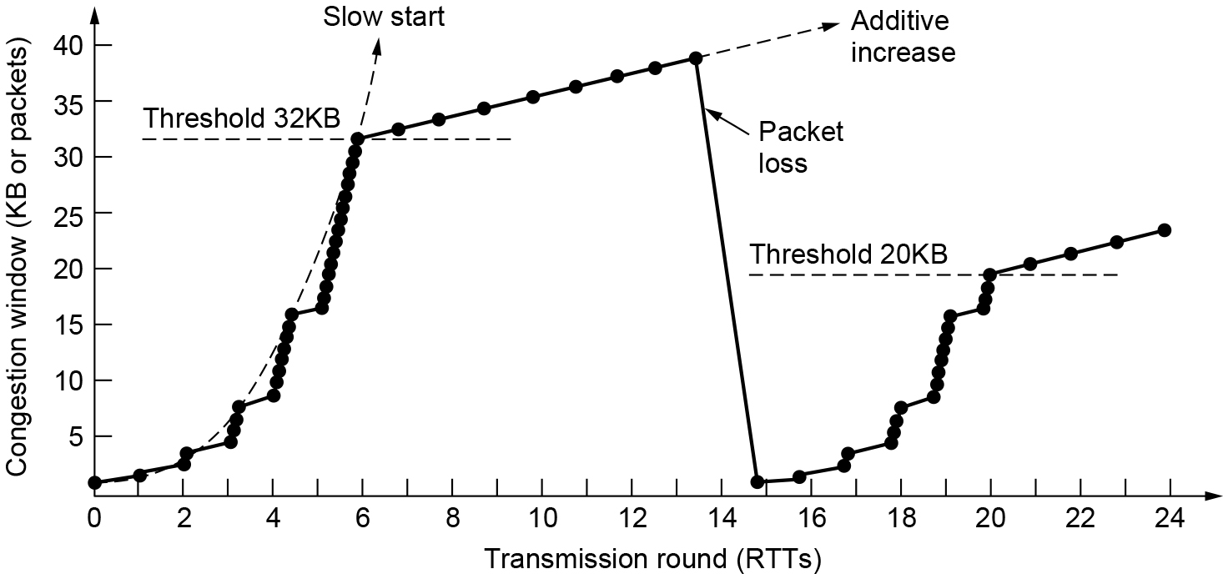
TCP Congestion Control (4 of 6)
Slow start followed by additive increase in TCP Tahoe

Slide 58
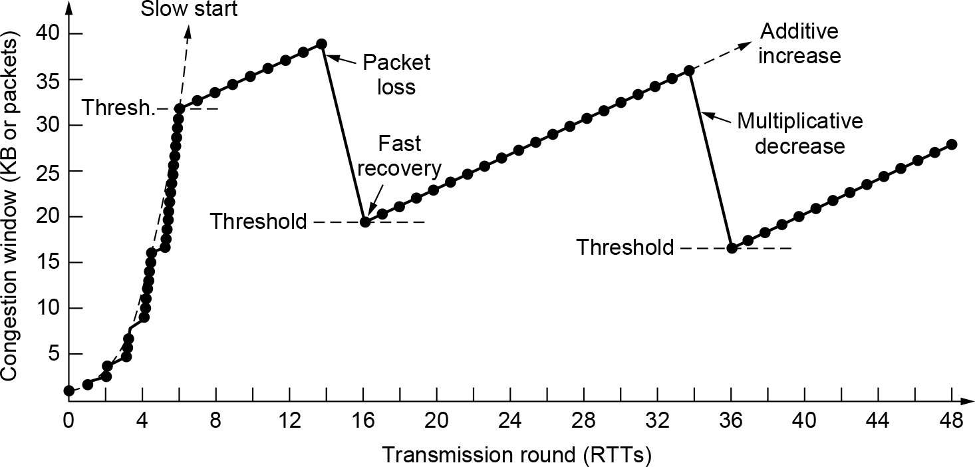
TCP Congestion Control (5 of 6)
Fast recovery and the sawtooth pattern of TCP Reno

Slide 59
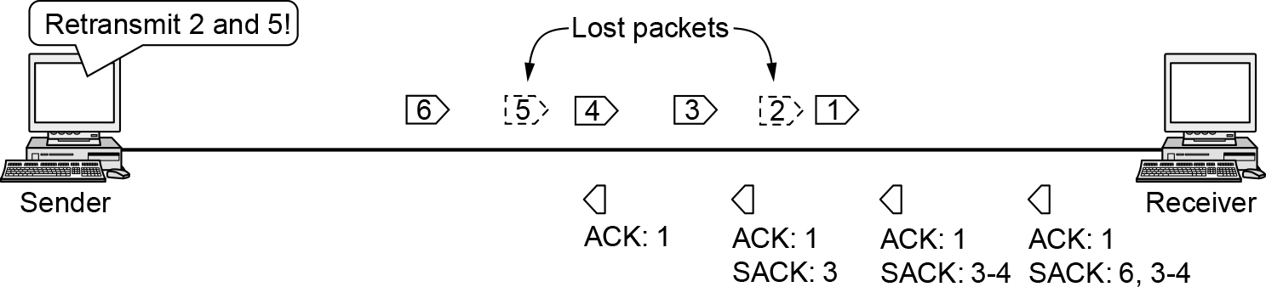
TCP Congestion Control (6 of 6)
Selective acknowledgements

Slide 60

TCP CUBIC
Evolution of TCP CUBIC Congestion Window

Slide 61
Transport Protocols and Congestion Control
QUIC: Quick UDP Internet Connections
BBR: Congestion control based on bottleneck bandwidth
The future of TCP

Slide 62

BBR: Congestion Control Based on Bottleneck Bandwidth
BBR Operating Point

Slide 63
The Future of TCP
TCP will continue to evolve
TCP issues
Does not provide transport semantics applications want
Application must deal with problems not solved by TCP
Proposals providing a slightly different interface
SCTP and SST
Must deal with “If it ain’t broke, don’t fix it’’ mentality

Slide 64
Performance Issues
Performance problems
Measuring network performance
Measuring access network throughput
Measuring quality of experience
Host design for fast networks
Fast segment processing
Header compression
Protocols for ‘‘long fat’’ networks

Slide 65
Performance Problems in Computer Networks
Temporary resource overloads
Structural resource imbalance
Synchronous overloads
Broadcast storm from a bad segment
Power returning after power failure
Lack of system tuning
Low buffer space
Setting timeouts
Jitter

Slide 66
Network Performance Measurement
Access network throughput measurement
Run speed test
Measuring link access speed has become more challenging
Filling the pipe requires more data
Under-test client/server bottlenecks move elsewhere in the network
Speed is less relevant to network performance
Quality of experience or application performance more important

Slide 67
Measuring Access Network Throughput
Best practices
Use multiple parallel TCP connections to fill the capacity of the access link
Perform access network throughput tests directly from the home router
Measure multiple Internet destinations in parallel from a single access connection
Develop ‘‘passive’’ throughput tests

Slide 68
Measuring Quality of Experience
Modern network performance measurement
Moving beyond simple speed tests
Typically based on passive observation of network traffic
User’s quality of experience
Measures person’s happiness with a service
A human consideration
Might require human feedback
Future technique
Automatic estimation of user quality of experience
Based on passive measurement of features in network traffic

Slide 69
Host Design for Fast Networks
Host speed is more important than network speed
Reduce packet count to reduce overhead
Minimize data touching
Minimize context switches
Avoiding congestion is better than recovering from it
Avoid timeouts

Slide 70

Minimize Context Switches
Four context switches to handle one packet with a user-space network manager

Slide 71

Fast Segment Processing (1 of 3)
The fast path from sender to receiver is shown with a heavy line. The processing steps on this path are shaded.

Slide 72

Fast Segment Processing (2 of 3)
(a) TCP header. (b) IP header. In both cases, they are taken from the prototype without change.

Slide 73

Fast Segment Processing (3 of 3)
A timing wheel

Slide 74

Protocols for Long Fat Networks (1 of 2)
The state of transmitting 1 Mbit from San Diego to Boston. (a) At t = 0. (b) After 500 µsec. (c) After 20 msec. (d) After 40 msec.

Slide 75

Protocols for Long Fat Networks (2 of 2)
Time to transfer and acknowledge a 1-Mbit file over a 4000-km line

Slide 76

Copyright
This work is protected by United States copyright laws and is provided solely for the use of instructors in teaching their courses and assessing student learning. Dissemination or sale of any part of this work (including on the World Wide Web) will destroy the integrity of the work and is not permitted. The work and materials from it should never be made available to students except by instructors using the accompanying text in their classes. All recipients of this work are expected to abide by these restrictions and to honor the intended pedagogical purposes and the needs of other instructors who rely on these materials.

